Slide 1

Introduction to WASP Toxi
Lake Example
River Example

Slide 2
Lake Example
I1DISP Default Values

Slide 3
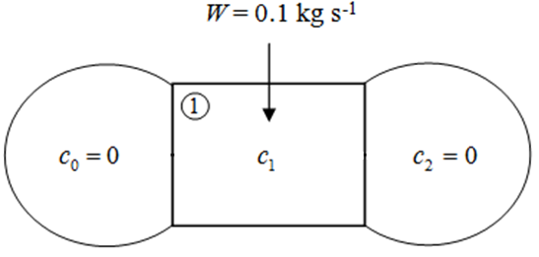
Lake Example
A = 20 m² L = 1000 m W = 0.1 kg/s
k = 10⁻⁴ s⁻¹

Slide 4
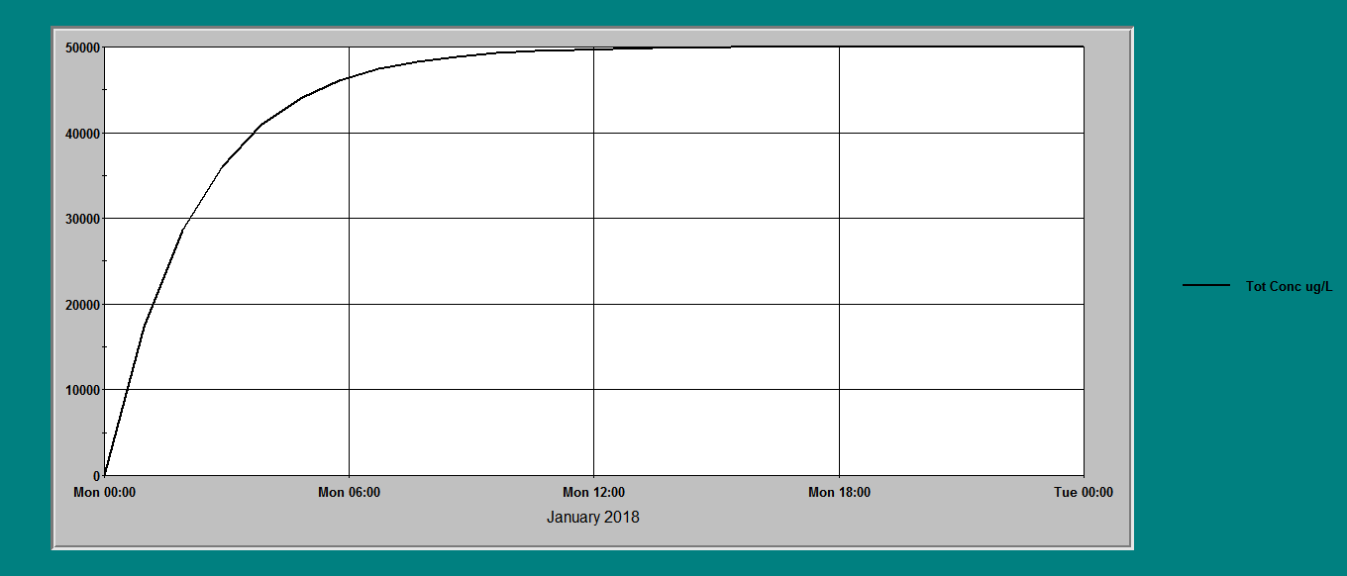
Lake Example – WASP Toxi

Slide 5
River Examples
Examples 3.2 – 3.3

Slide 6
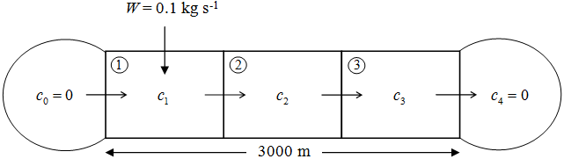
Example 3.2 - Summary
A = 20 m² L = 3000 m u = 0.1 m/s
E = 0.2 m²/s Δx = 1000 m W = 0.1 kg/s
k = 10⁻⁴ s⁻¹

Slide 7
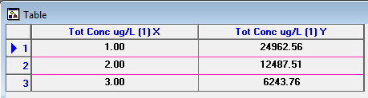
Example 3.2 – Solution

Slide 8
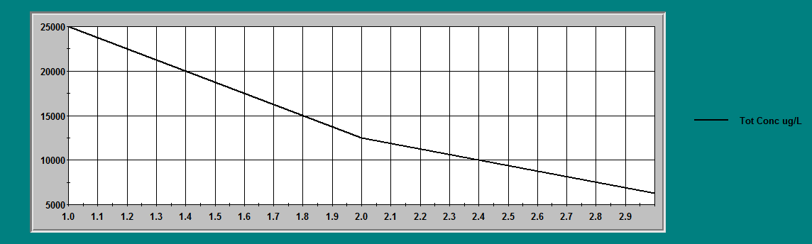
Example 3.2 – WASP Toxi

Slide 9
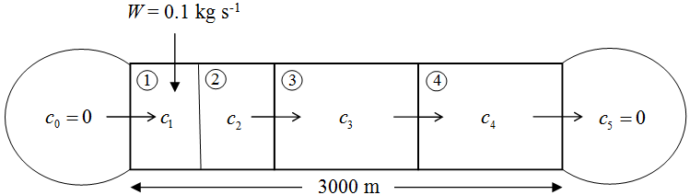
Example 3.3 - Summary
A = 20 m² L = 3000 m u = 0.1 m/s
E = 0.0 m²/s Δx = 1000 m W = 0.1 kg/s
k = 10⁻⁴ s⁻¹

Slide 10
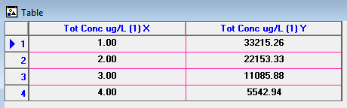
Example 3.3 – Analytical Solution

Slide 11
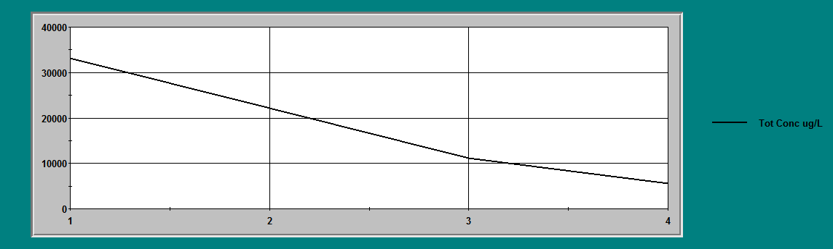
Example 3.3 – WASP Toxi

Slide 12
Thank you
Presented by
Assoc. Prof. Dr. Teh Su Yean | School of Mathematical Sciences

